Slide 1
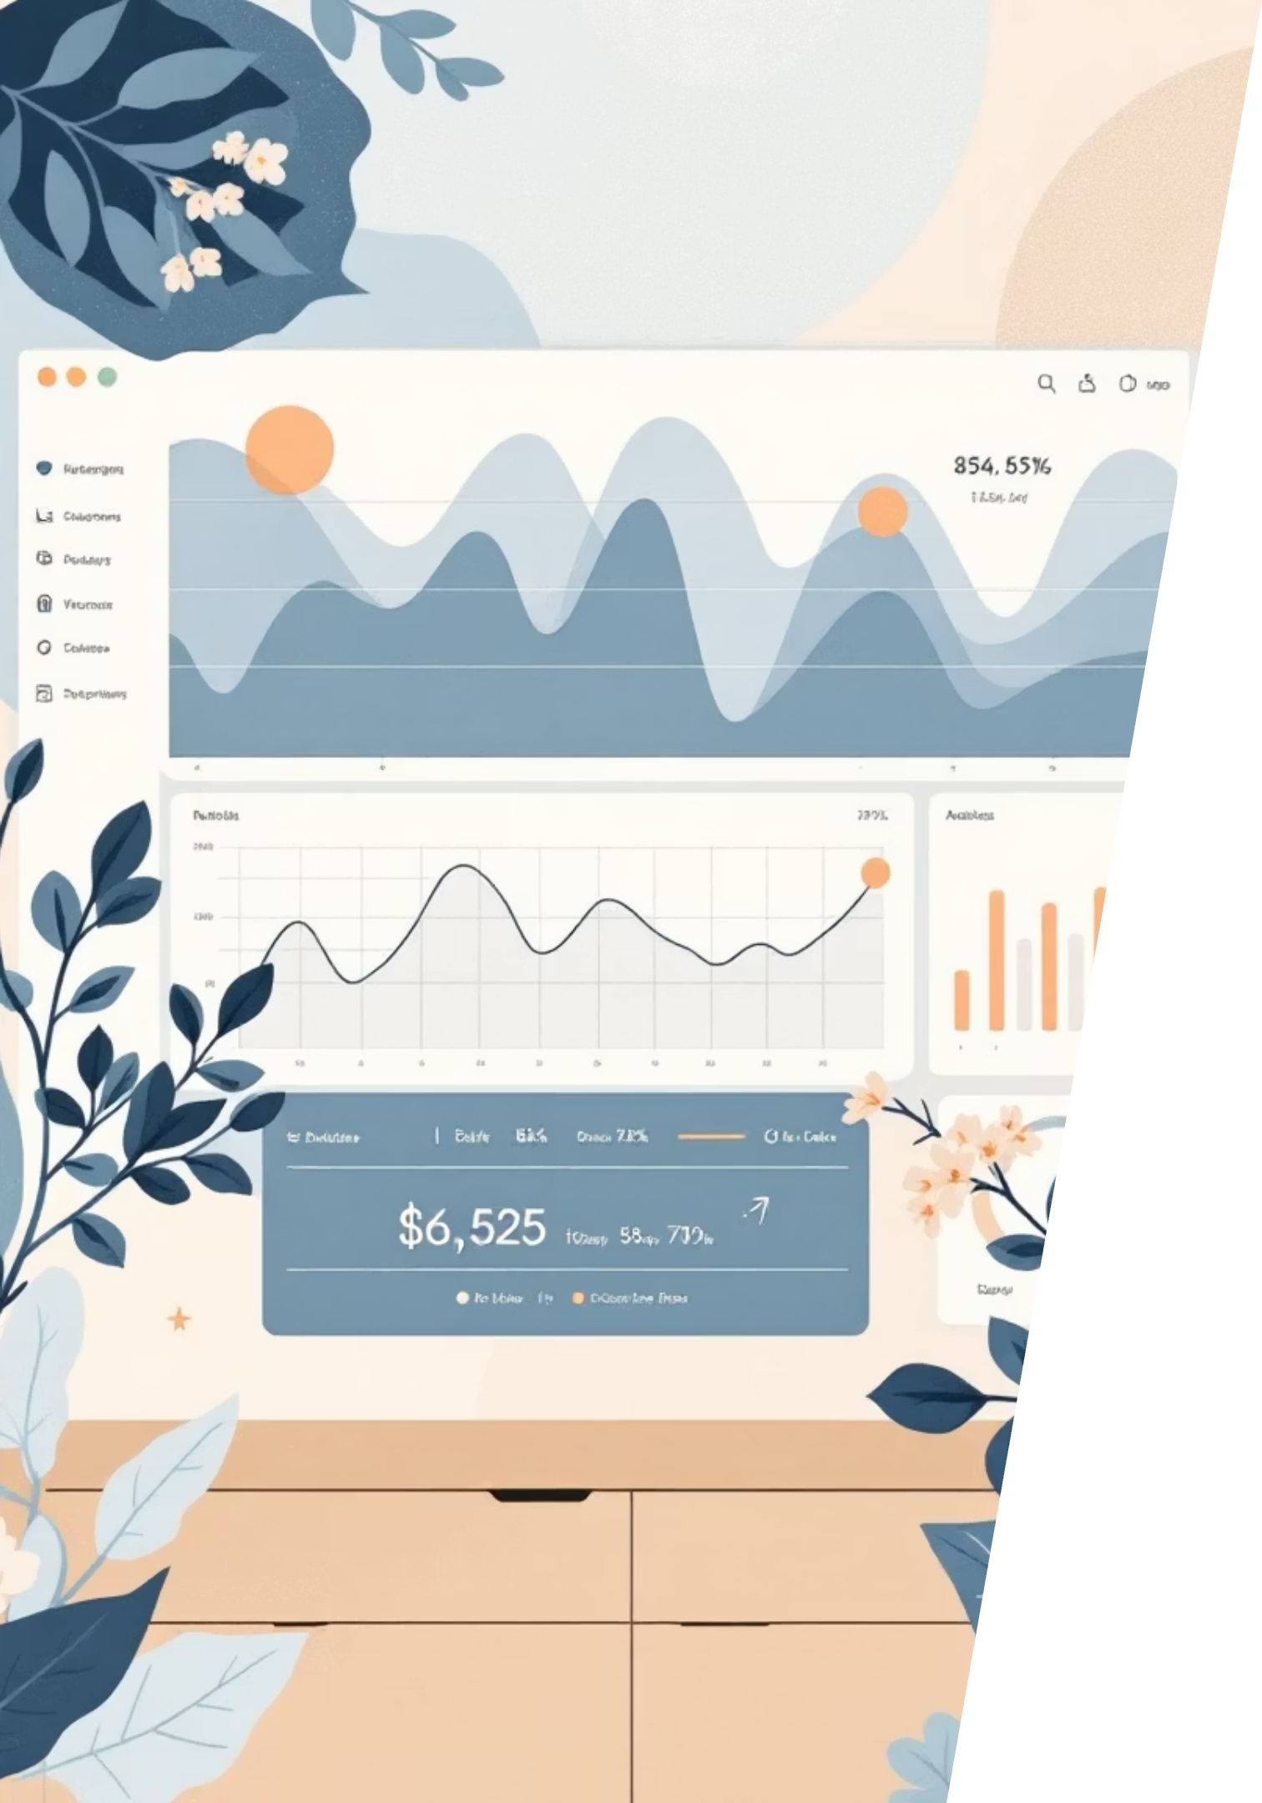
Customer Shopping Behavior Analysis
Uncovering insights from 3,900 purchases to drive strategic business decisions

Slide 2

Dataset Overview
3,900
18
50
25
Total Purchases
Data Columns
Locations
Product Types
Transactions analyzed across all categories
Comprehensive customer and purchase attributes
Geographic diversity in customer base
Diverse inventory across categories

Slide 3
Data Preparation Journey
01
02
Data Loading & Exploration
Cleaning & Standardization
Imported dataset using pandas, analyzed structure with df.info() and summary statistics
Handled 37 missing review ratings, standardized columns to snake_case format
03
04
Feature Engineering
Database Integration
Created age_group bins and purchase_frequency_days for deeper analysis
Connected to PostgreSQL, loaded cleaned data for SQL analysis

Slide 4
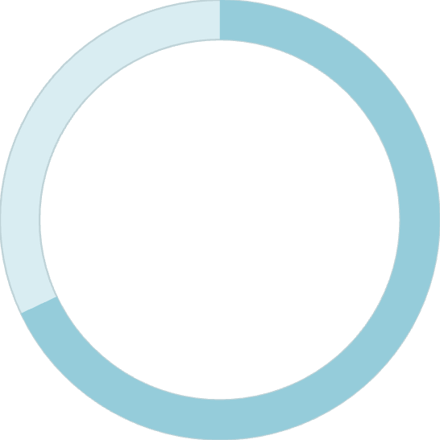

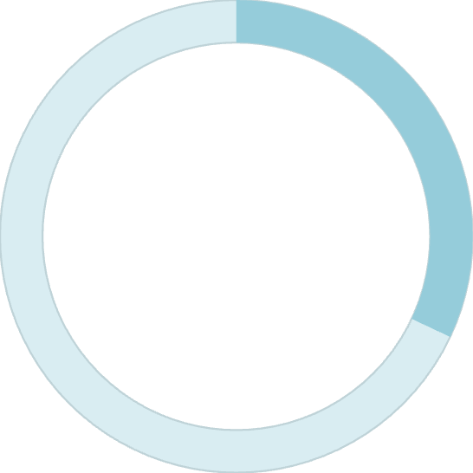
Revenue by Gender
68%
Male Customers
$157,890 total revenue
32%
Female Customers
$75,191 total revenue
Male customers drive majority of revenue, presenting opportunity for targeted female customer campaigns

Slide 5





Smart Discount Users
839 Customers
High-Value Segment
Strategic Opportunity
Used discounts but spent above average ($60)
Discount-responsive yet willing to spend more
Prime candidates for premium product promotions

Slide 6

Top-Rated Products
1
2
3
Gloves
Sandals
Boots
3.86 average rating
3.84 average rating
3.82 average rating
4
5
Hat
Skirt
3.80 average rating
3.78 average rating
Highlight these customer favorites in marketing campaigns and product positioning

Slide 7

Customer Loyalty Segments
Loyal
Returning
New
Loyal Customers Dominate
Growth Opportunity
80% of customer base shows strong repeat purchase behavior
Convert returning customers to loyal status through targeted programs

Slide 8


Subscription Insights
2,847
1,053
Non-Subscribers
Subscribers
$59.87 avg spend
$59.49 avg spend
Repeat buyers (>5 purchases): 958 subscribers vs 2,518 non-subscribers
Subscription conversion opportunity: Even loyal customers aren't subscribing at high rates

Slide 9
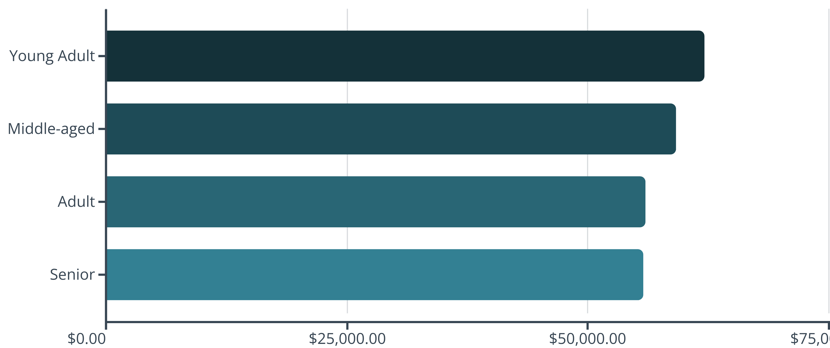
Revenue by Age Group
Young adults lead revenue generation, but all segments contribute relatively evenly

Slide 10
Strategic Recommendations
Boost Subscriptions
Loyalty Programs
Review Discounts
Product Positioning
Promote exclusive benefits to convert loyal non-subscribers
Reward repeat buyers to accelerate segment progression
Balance promotional sales with healthy profit margins
Highlight top-rated items in marketing campaigns
Targeted Marketing
Focus on high-revenue age groups and express shipping users

